Slide 1
Cornerstone City Church Peninsula Plus Community Hoo Are Ya
16th November 2025

Slide 2
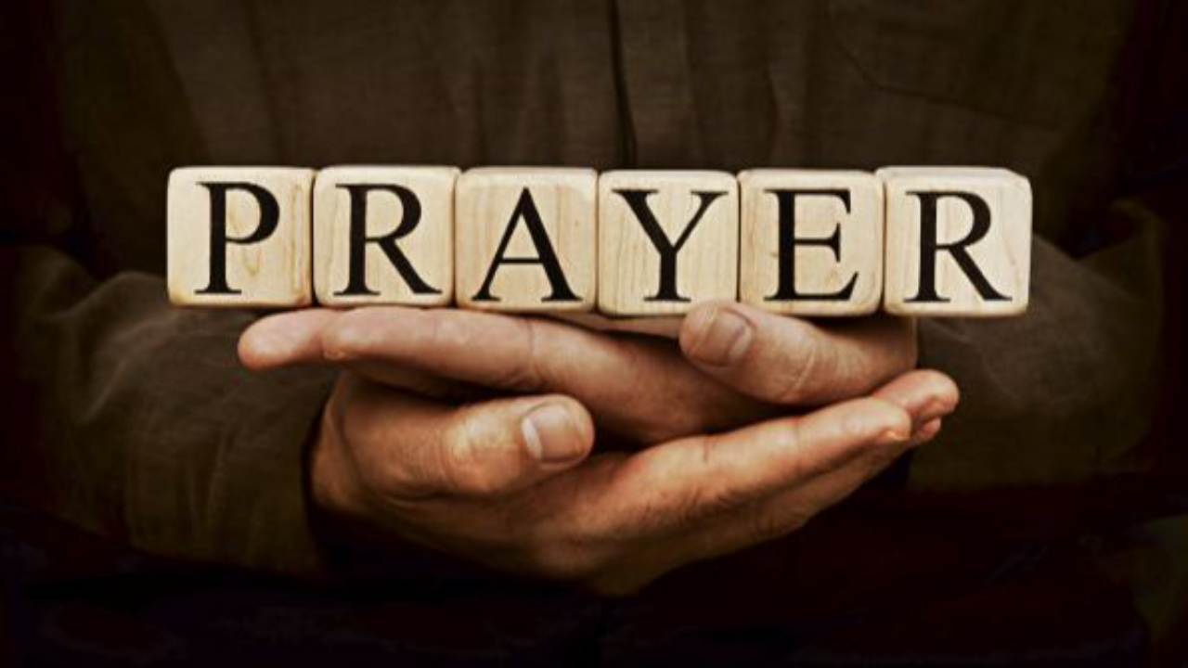

Slide 3
I know That I Know CCLI Song # 7242526
Alexander Pappas | Andrew Holt | Austin Davis
© 2025 A.L.K.D. Music; Andrew Holt Music Publishing; Capitol CMG Paragon; TBCO Publishing; City and Vine Music Publishing International
For use solely with the SongSelect® Terms of Use. All rights reserved. www.ccli.com

Slide 4
1/8
You’ve been good good for all my life
So nothing could ever change my mind
You never break Your promise
You’re constant in all You do
Yours is the way the truth the life
That I will choose

Slide 5
2/8
Oh I know that I know
You won’t ever let me go
Every low every high
You are faithful all the time
I’ve tasted and I’ve seen
You've been so so good to me
God I know that I know

Slide 6
3/8
You're faithful all the time oh
You're faithful all the time oh

Slide 7
4/8
I won’t look to the left or right
And I will keep heaven in my sight
No I will not be shaken
And nothing is moving me
I’ve got a faith that's sure of things
I cannot see

Slide 8
5/8
Oh I know that I know
You won’t ever let me go
Every low every high
You are faithful all the time
I’ve tasted and I’ve seen
You've been so so good to me
God I know that I know

Slide 9
6/8
You're faithful all the time oh
You're faithful all the time oh

Slide 10
7/8
I won’t stand on words of man
God I’ll stand on Yours instead
All of my hope all of my faith
All of it’s in Your name
And the world cannot deny
All that You’ve done in my life
All of my days all of my praise
All to lift Jesus' name

Slide 11
8/8
Oh I know that I know
You won’t ever let me go
Every low every high
You are faithful all the time

Slide 12
8/8
I’ve tasted and I’ve seen
You've been so so good to me
God I know that I know You're faithful all the time oh
You're faithful all the time oh You're faithful all the time oh
You're faithful all the time oh Faithful all the time

Slide 13
He Lives
CCLI Song # 7133098
Anthony Skinner | Chris McClarney | Jonathan Smith
© 2020 Capitol CMG Genesis; Be Essential Songs; Cashagamble Jet Music; Bethel Music Publishing SESAC; Thirsty Boots Music
For use solely with the SongSelect® Terms of Use. All rights reserved. www.ccli.com

Slide 14
1/7
See the tomb where He laid
See the stone rolled away
He is risen He is risen He's alive
See His hands see His feet
Touch His scars and believe
He is risen He is risen He's alive
Oh He's alive

Slide 15
2/7
He lives
All honour and power are His
All glory forever amen
Jesus (lives)
(Jesus lives)

Slide 16
3/7
Hear the shackles breaking free
Hear the song of the redeemed
He is moving He is moving He's alive
So take this freedom take this love
Can you feel it rising up
He is here He is here He's alive

Slide 17
4/7
He lives
All honor and power are His
All glory forever amen
Jesus (lives)
(Jesus lives)

Slide 18
5/7
You took all our shame
Left it in the grave
We're forgiven we're forgiven
The work forever done
Only by the blood
It is finished it is finished

Slide 19
6/7
He lives
All honor and power are His
All glory forever amen
Jesus (lives)
(Jesus lives)

Slide 20
7/7
He is risen He is risen He's alive

Slide 22
All Hail King Jesus CCLI Song # 7097216
Jeremy Riddle | Peter Mattis | Ran Jackson | Steffany Gretzinger
© 2017 Richmond Park Publishing; Bethel Music Publishing; Jeremy Riddle Music Designee
For use solely with the SongSelect® Terms of Use. All rights reserved. www.ccli.com
CCLI Licence No. 33265

Slide 23
1/8
There was a moment when the lights went out
When death had claimed its victory
The King of Love had given up His life
The darkest day in history

Slide 24
2/8
There on a cross they made for sinners
For every curse His blood atoned
One final breath and it was finished
But not the end we could have known

Slide 25
3/8
For the earth began to shake
And the veil was torn
What sacrifice was made
As the heavens roared

Slide 26
4/8
All hail King Jesus
All hail the Lord of Heaven and earth
All hail King Jesus
All hail the Savior of the world

Slide 27
5/8
There was a moment when the sky lit up
A flash of light breaking through
When all was lost He crossed eternity
The King of life was on the move

Slide 28
6/8
For in a dark cold tomb
Where our Lord was laid
One miraculous breath
And we're forever changed

Slide 29
7/8
Let every knee come bow before the King of Kings
Let every tongue confess that He is Lord
Lift up your shout let us join with all of Heaven
Singing Holy
Singing Holy
Cry out Holy
Singing Holy

Slide 30
8/8
All hail King Jesus
All hail King Jesus
All hail King Jesus
All hail King Jesus

Slide 32
In Christ Alone
CCLI Song # 3350395
Keith Getty | Stuart Townend
© 2001 Thankyou Music (Admin. by Integrity Music Ltd)
For use solely with the SongSelect® Terms of Use. All rights reserved. www.ccli.com
CCLI Licence No. 33265

Slide 33
1/4
In Christ alone my hope is found
He is my light my strength my song
This Cornerstone this solid Ground
Firm through the fiercest drought and storm
What heights of love what depths of peace
When fears are stilled when strivings cease
My Comforter my All in All
Here in the love of Christ I stand

Slide 34
2/4
In Christ alone who took on flesh
Fullness of God in helpless babe
This gift of love and righteousness
Scorned by the ones He came to save
Till on that cross as Jesus died
The wrath of God was satisfied
For every sin on Him was laid
Here in the death of Christ I live

Slide 35
3/4
There in the ground His body lay
Light of the world by darkness slain
Then bursting forth in glorious Day
Up from the grave He rose again
And as He stands in victory
Sin's curse has lost its grip on me
For I am His and He is mine
Bought with the precious blood of Christ

Slide 36
4/4
No guilt in life no fear in death
This is the power of Christ in me
From life's first cry to final breath
Jesus commands my destiny
No power of hell no scheme of man
Can ever pluck me from His hand
Till He returns or calls me home
Here in the power of Christ I'll stand

Slide 38
Here Is Love
CCLI Song # 3287884
Matt Redman | Robert Lowry | William Rees
© 2004 Thankyou Music (Admin. by Integrity Music)
For use solely with the SongSelect® Terms of Use. All rights reserved. www.ccli.com
CCLI Licence No. 33265

Slide 39
1/3
Here is love vast as the ocean Loving-kindness as the flood When the Prince of Life our Ransom Shed for us His precious blood
Who His love will not remember Who can cease to sing His praise He can never be forgotten Throughout Heav'n's eternal days

Slide 40
2/3
On the mount of crucifixion Fountains opened deep and wide Through the floodgates of God's mercy Flowed a vast and gracious tide Grace and love like mighty rivers Poured incessant from above Heav'n's peace and perfect justice Kissed a guilty world in love

Slide 41
3/3
Let us all His love accepting Love Him ever all our days Let us seek His kingdom only And our lives to be His praise He alone shall be our glory Nothing in the world we see For He has cleansed and sanctified us He Himself has set us free

Slide 42


Slide 43
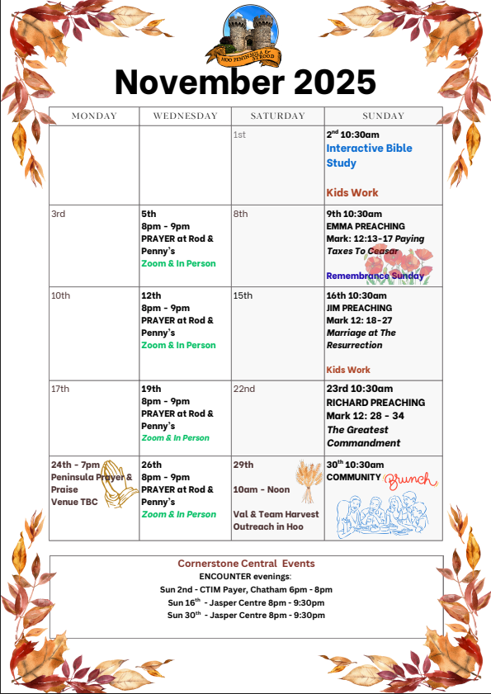

Slide 44
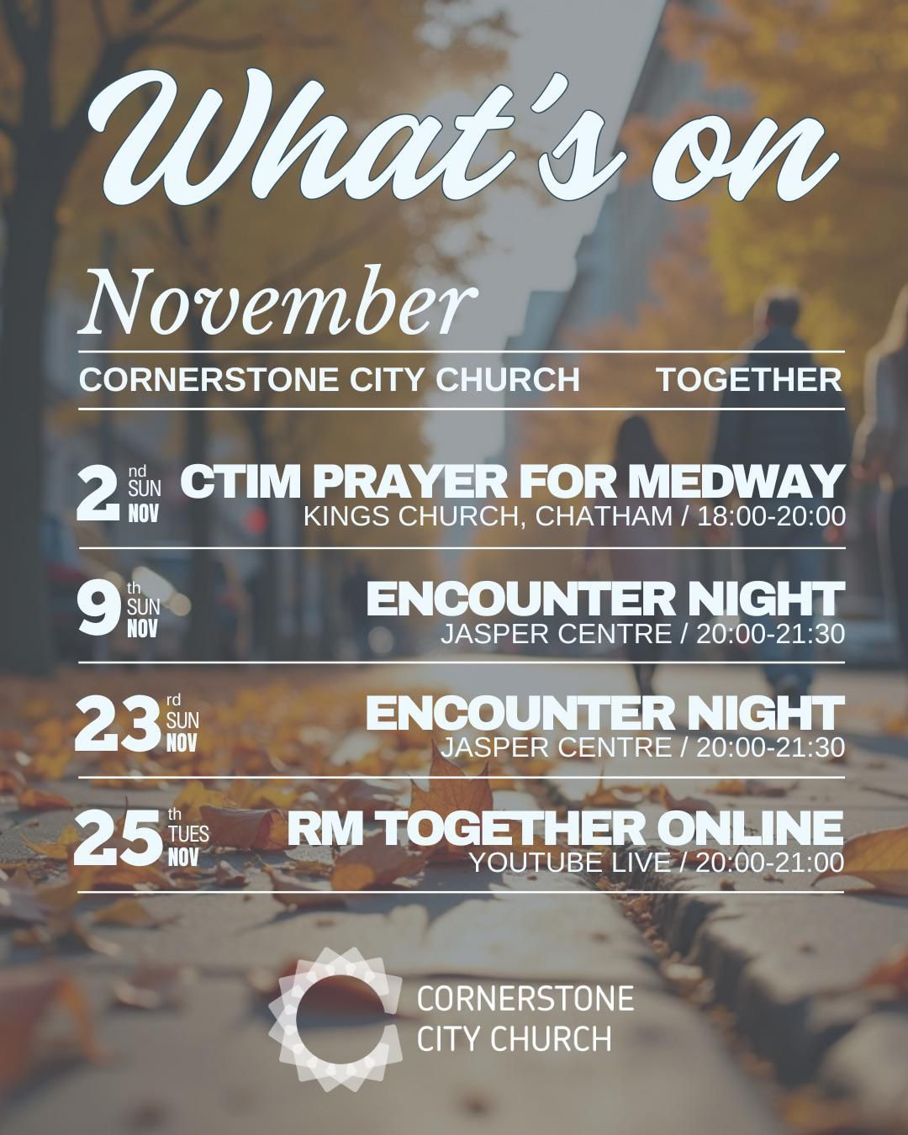

Slide 45
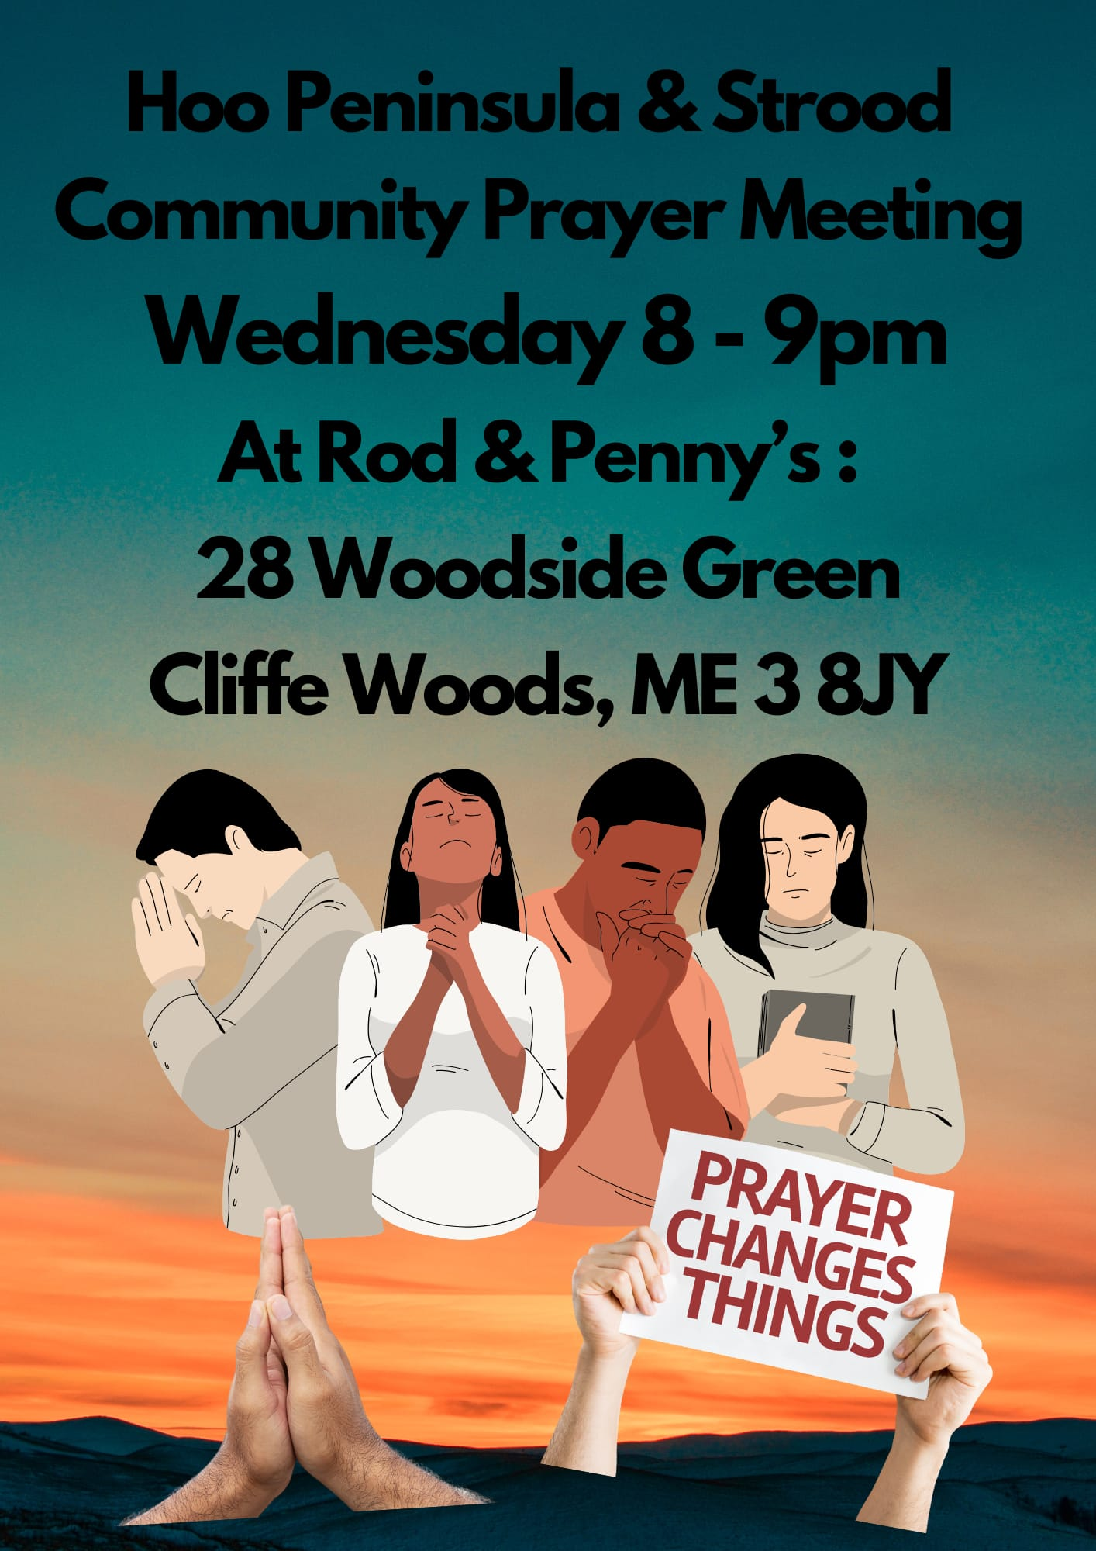

Slide 46
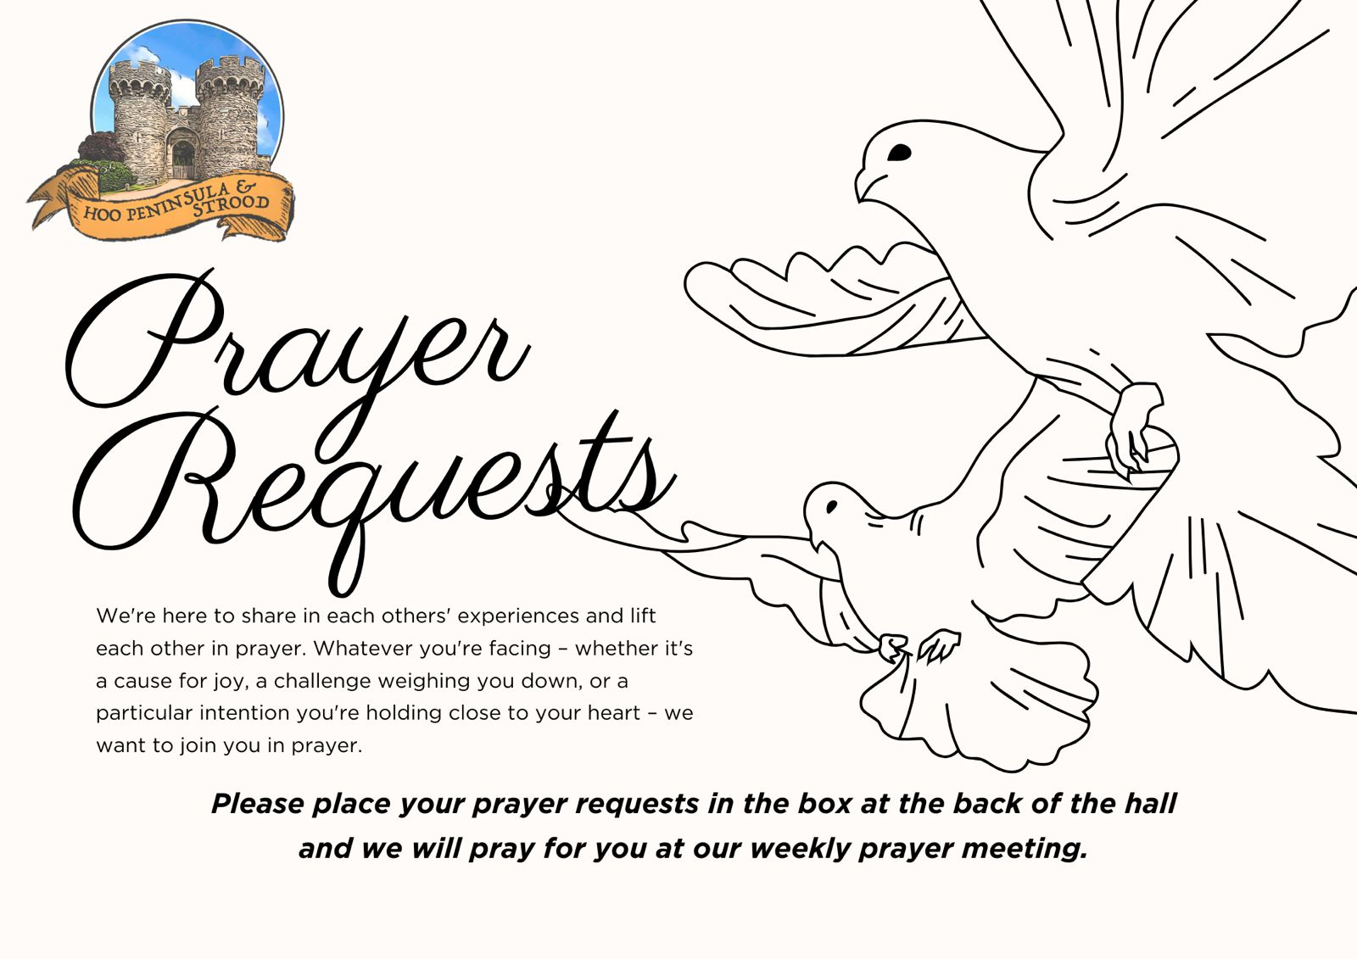

Slide 47


Slide 48
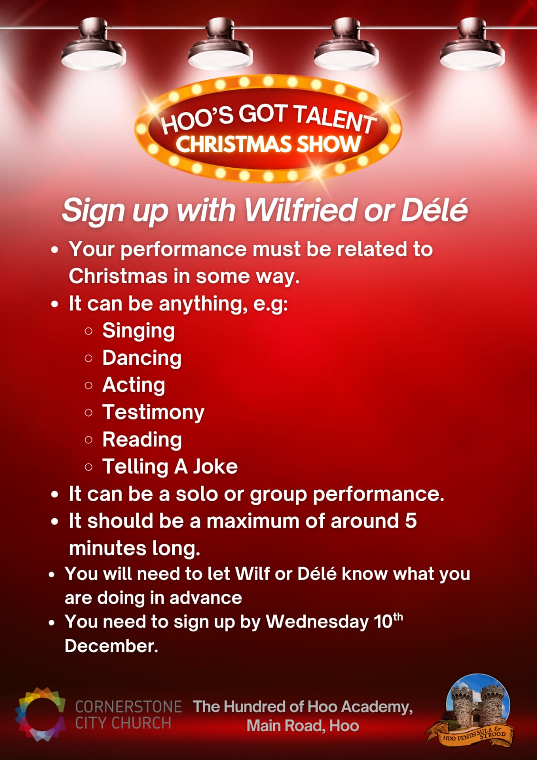

Slide 49

Grow Group 1
On YOUR MARK!

Slide 50
Leaders
Leaderss
Phil & Kim
Maria (Mia) Warren
Matthew Harrison
Richard & Elisha Acheampong
Phil & Kim
Maria (Mia) Warren
Matthew Harrison
Richard & Elisa Acheampong

Slide 51
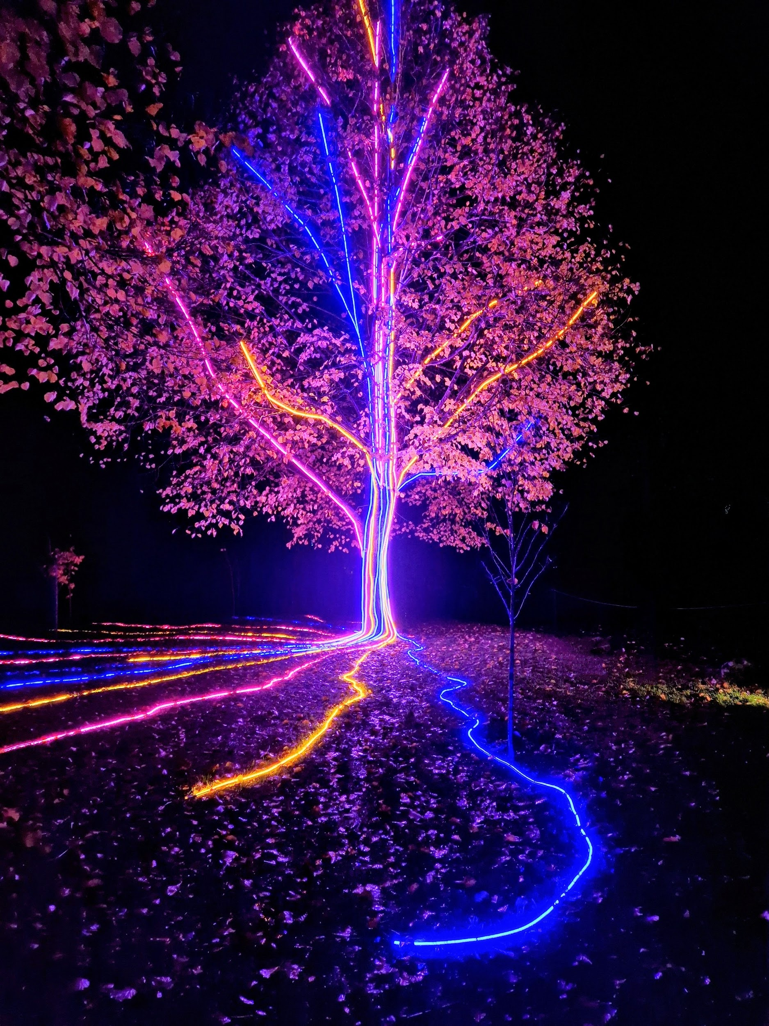
Storm Walker
Storm Walker
Symbolising, trust in Jesus Christ through life's storms.
Mark 4:35-41

Slide 52
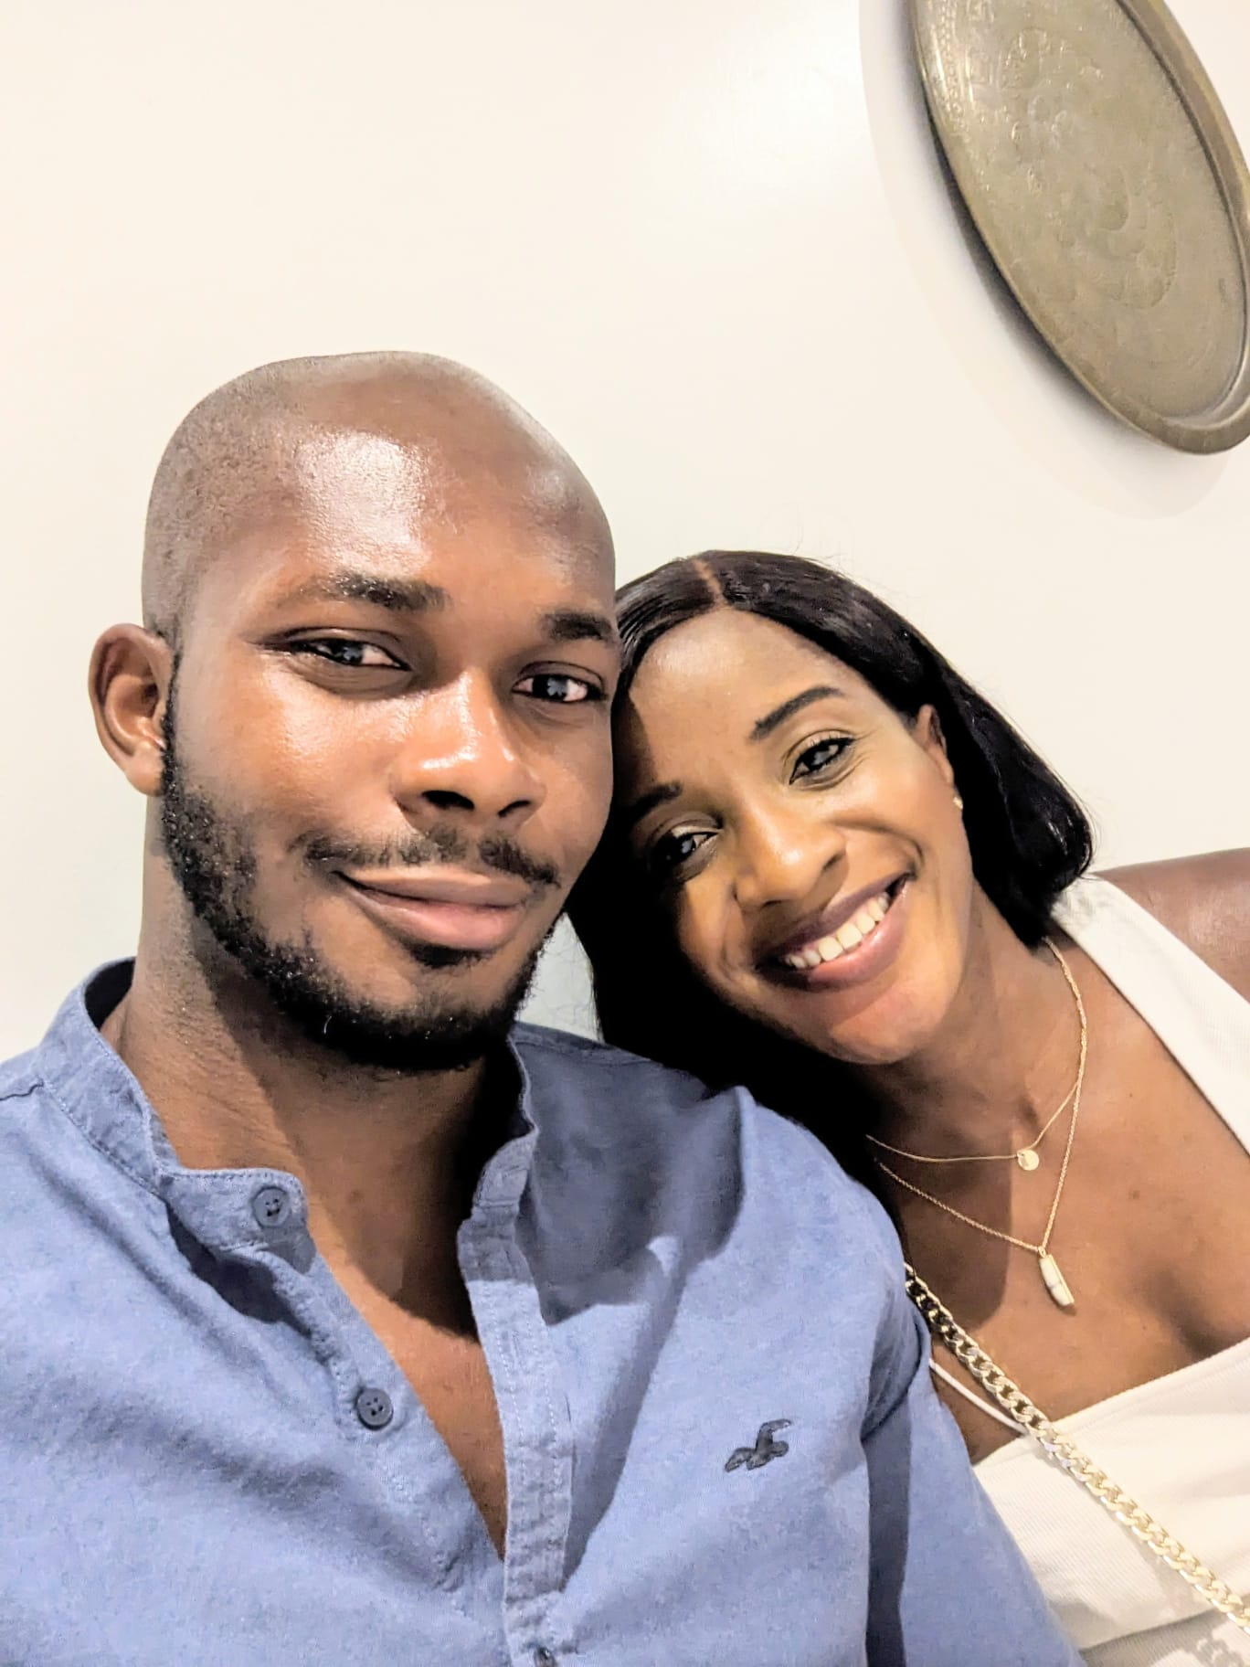

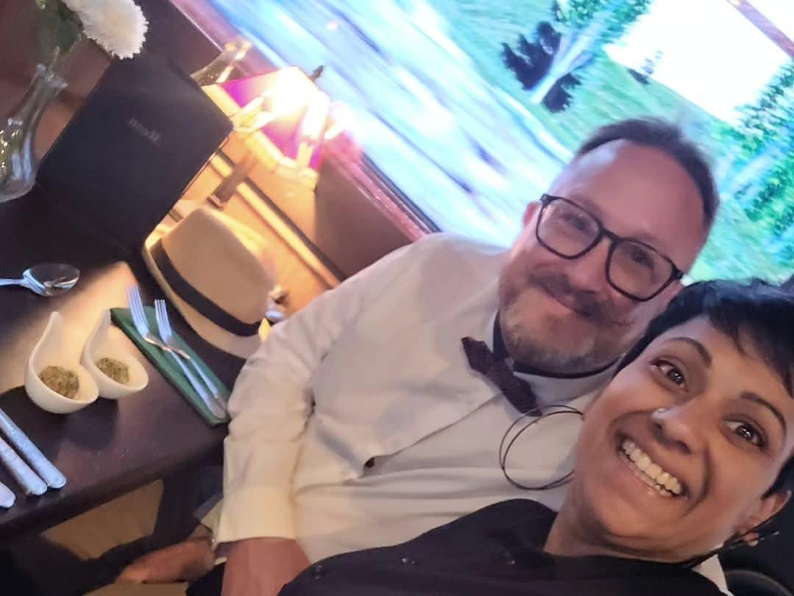
Group Leaders
Micheal and Mwamba
Wilfred and Parveen
Hannah

Slide 53


Slide 54


Slide 55


Slide 56
2 Corinthians 14 May the grace of the Lord Jesus Christ, and the love of God, and the fellowship of the Holy Spirit be with you all
Surely goodness and mercy shall follow us all the days of our lives, and we shall dwell in the house of the Lord forever.

